Slide 1
Guidance Meeting: Capstone Project
Group:eShield Professor: Laha Sir

Slide 2
Objective
Understanding Cyber Security and Safety Perceptions for Digital Payments
and E-Services

Slide 3
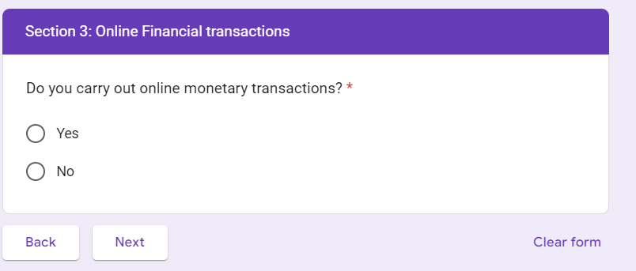
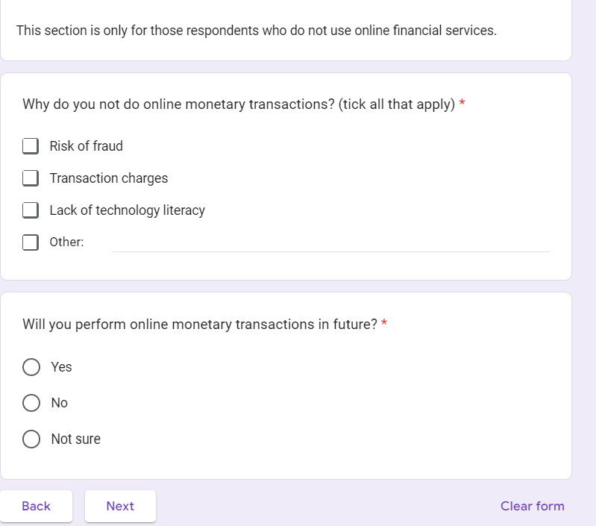
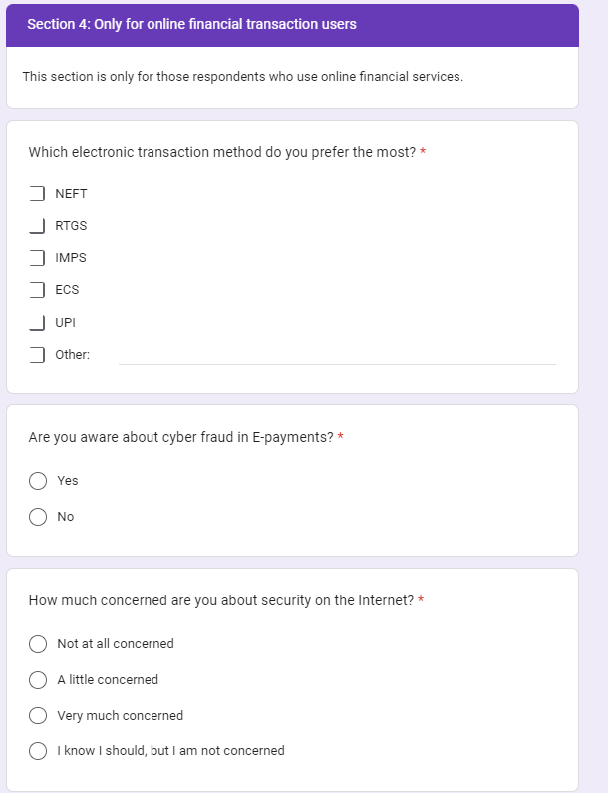
Survey Form Snipshots

Slide 4
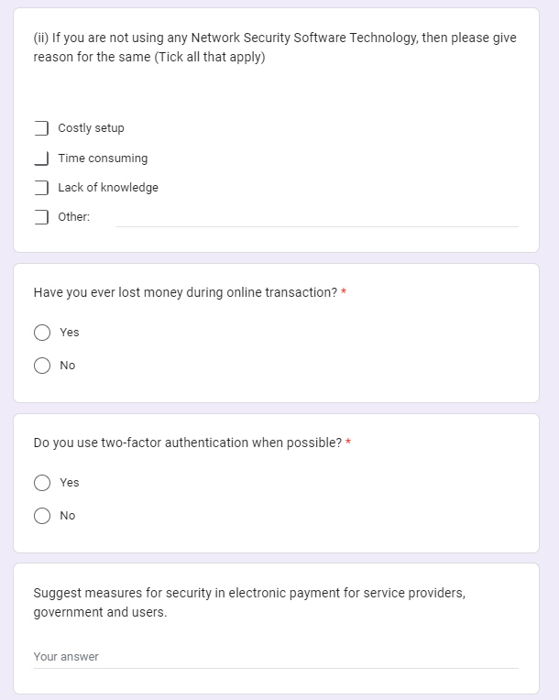
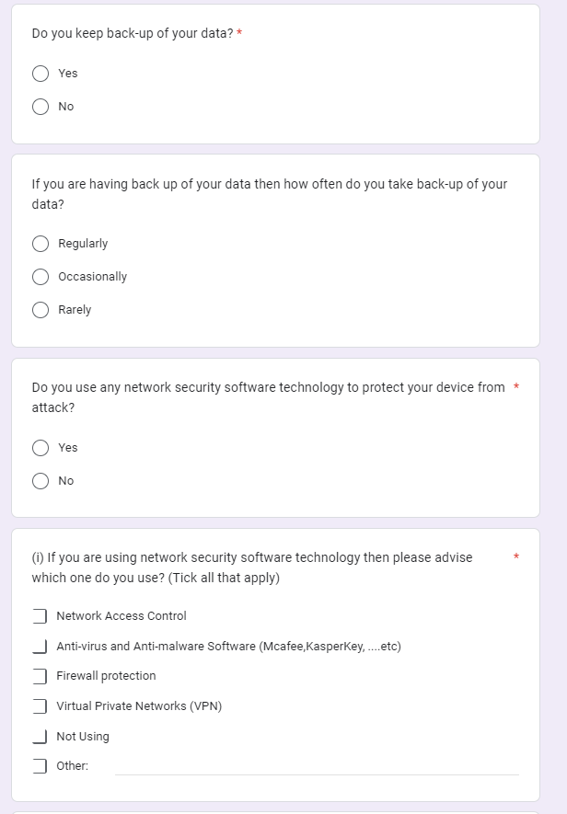
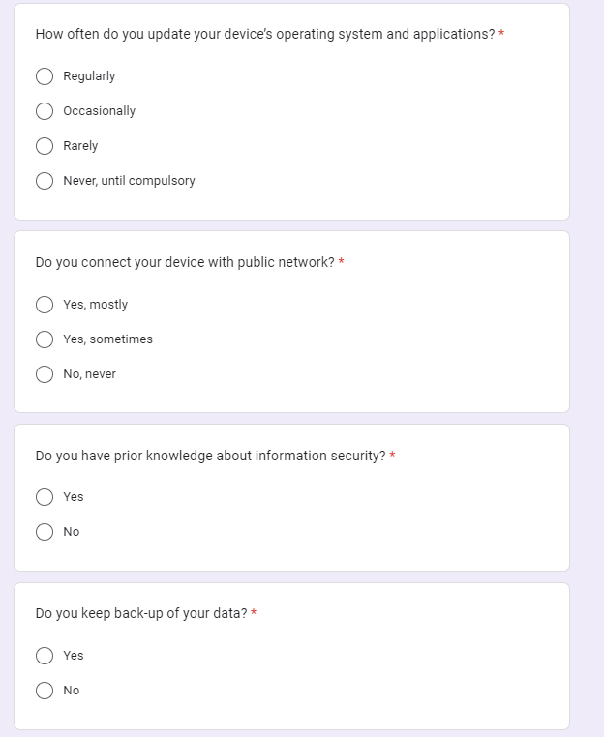
Survey Form Snipshots

Slide 5
Total Responses Received
106
Total Variables
24

Slide 6
Total Variables from Survey Form
List of Variables
Concern(cyber security) | Operating System Update
online payment | Security Software Use
aware of cyber fraud | Two factor authentication -use
Money lost | Public network -use
backup data | Authentication Method
back up frequency | Policy Reading
knowledge of IT | virtual(soft) keyboard -use
Understand cookies | privacy perception
web add check | AI- Useful
chatboat -use | Age
Education | Gender
Income | Occupation
24

Slide 7
Selection of Response Variable
Response Variable - Selected
Concern(cyber security) | Operating System Update
Online payment | Security Software Use
aware of cyber fraud | Two factor authentication -use
Money lost | Public network -use
Backup data | Authentication Method
Back up frequency | Policy Reading
Knowledge of IT | Virtual(soft) keyboard -use
Understand cookies | Privacy perception
Web add check | AI- Useful
Chatboat -use | Age
Education | Gender
Income | Occupation

Slide 8
Random Forest
Objective To study behaviour of those who are prone to become a victim of fraud(lossing money) during online transaction
Response Variable
Response variable is taken as Money lost by responder ( victim of fraud)
Predectors
There are 23 other predictors.
Few examples:age, education, profession, study, backup data, policy reading etc..

Slide 9
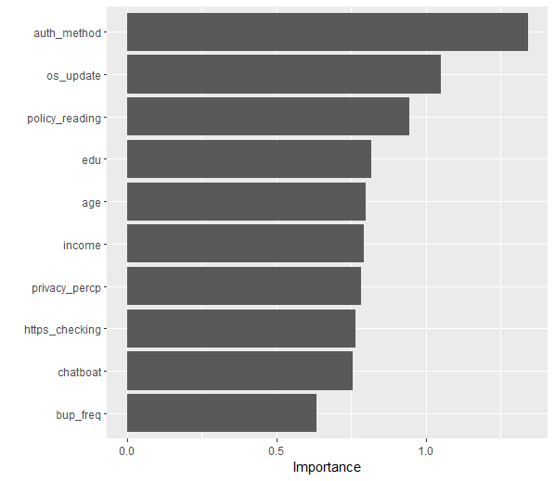
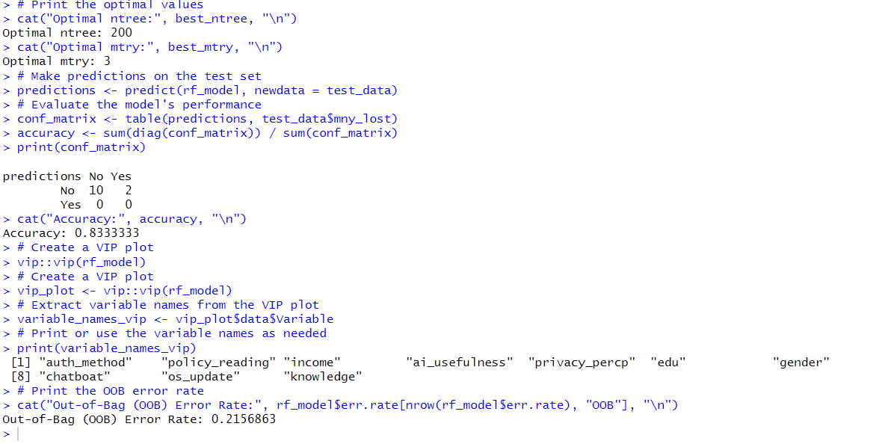
Random Forest

Slide 10
Response Variables from VIP(Random Forest)
Response Variable opted from VIP
Authentication Method
Operating System Update
Policy Reading
Money lost ( Response Variable)
Education
Back up frequency
Income
Age
Web add check
Chatboat -use
Privacy perception

Slide 11
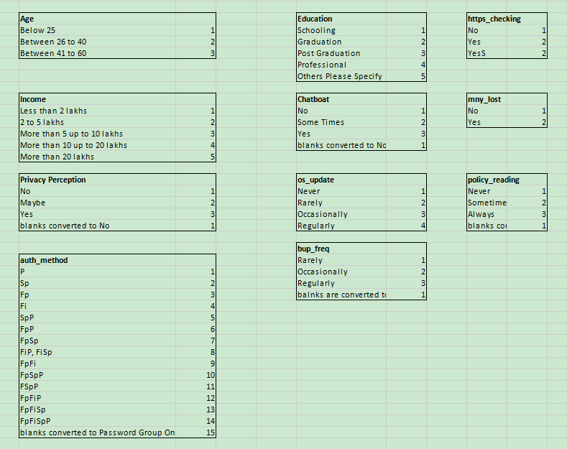
Lable Encoding of Variables

Slide 12
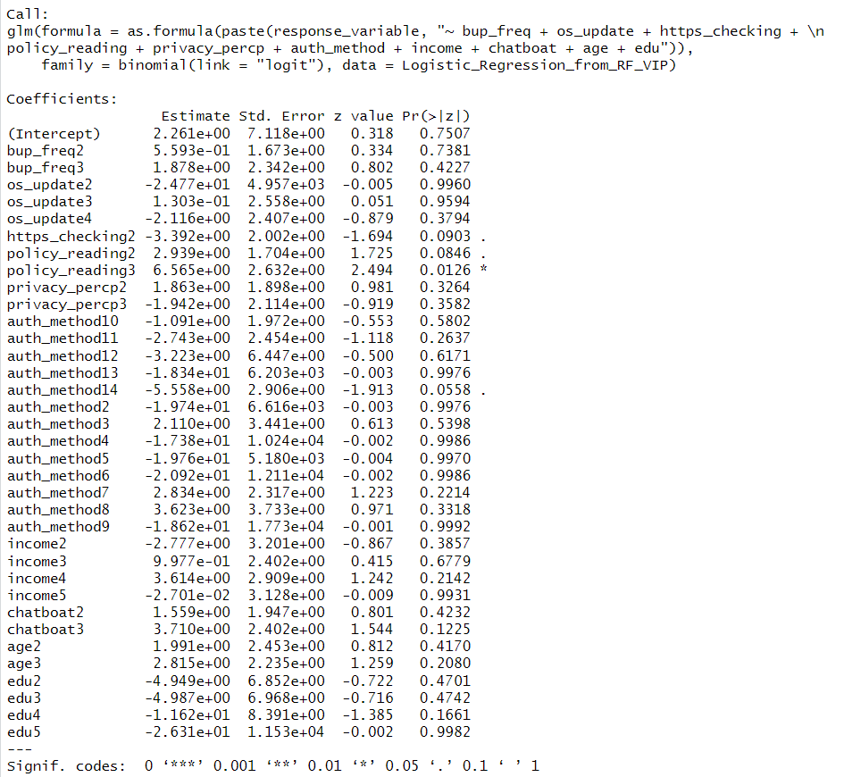
Logistic Regression: Output

Slide 13
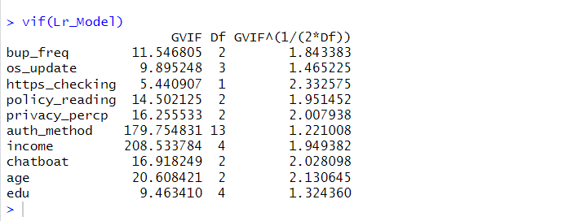
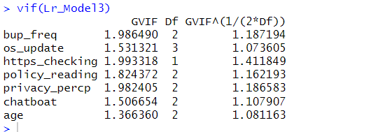
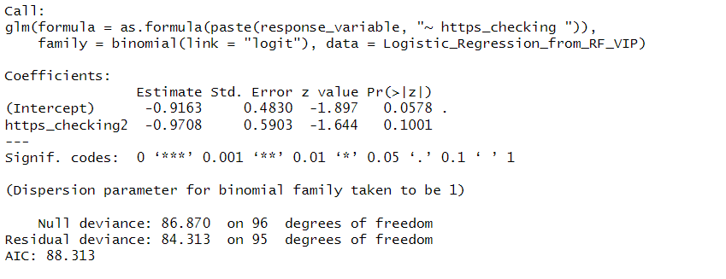
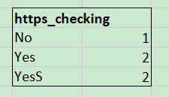
Backward Elimination Method
1
2
3

Slide 14
Logistic Model Inference
Individuals who engage in checking web.address demonstrate
Lower susceptibility to falling victim to financial fraud

Slide 15
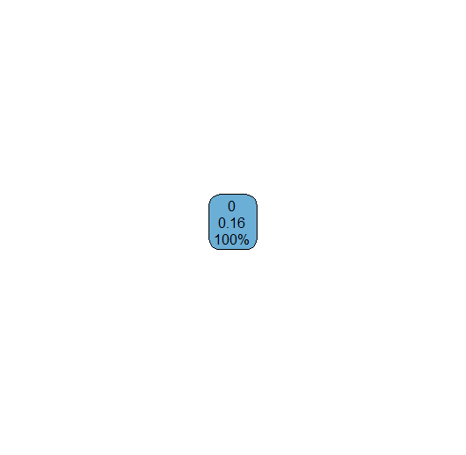
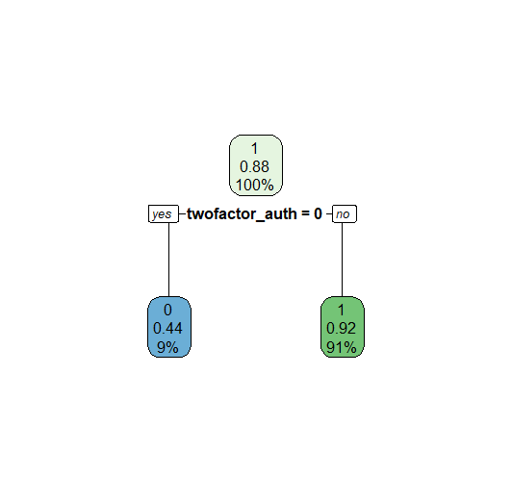
Decision Tree
Money Lost as Response
Concern(Cyber Security) as Response

